Slide 1
Supplier Audit Forms Training C-0002595 Rev G.

Slide 2
Supplier audit forms overview
The goal of the supplier audit is not only to understand supplier’s current overall condition and identify any risks to Creation; but also, to provide a path for supplier’s improvement and growth.
The supplier will go through the checklist and evaluate themselves in each section.
Creation auditor will review and evaluate each supplier response.
Creation may or may not perform an on-site audit.
If Creation performs an on-site audit, the auditor may or may not evaluate every element of the supplier self audit.

Slide 3
ADDITIONAL DOCUMENTATION
The following documentation may be requested during the audit.
Calibration schedule.
If external party, calibration certificate.
Maintenance schedule.
Maintenance order and report .
Internal (layered) audit schedule (if any).
Internal audit questionnaire (if any).
And other possible documents*
*Full list available on file C-0002595 Rev G.

Slide 4
TAB’s INDEX
History of changes
Instructions
Supplier information
Manufacturer audit
Distributor audit
Capacity audit
Report document
Development plan
Audit survey

Slide 5
SUPPLIER INFORMATION TAB
Creation representative will select the scope of the audit from this drop-down list
Creation representative will fill out the supplier information in these fields.
Supplier will fill up the supplier audit support personnel cells with the required information.

Slide 6
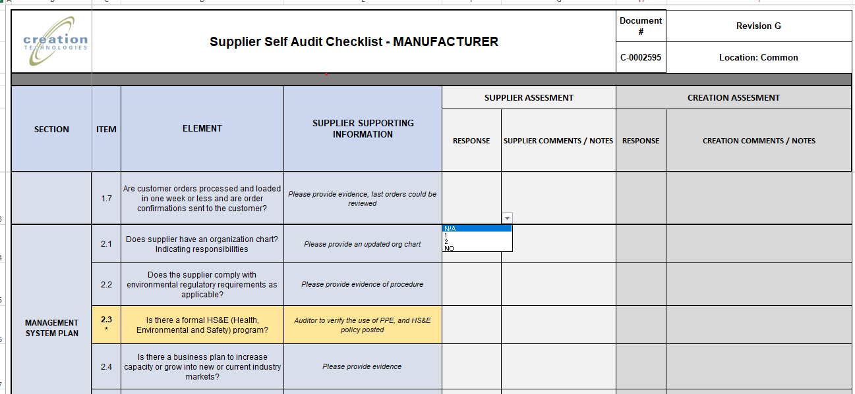
Manufacturer, distributor audit
Supplier representative will choose a response from the drop-down list based on current audit of each question. Acceptable responses are N/A, NO, 1 or 2 (being 1 for partial compliance and 2 for fully compliant)
Creation representative will choose a response from the drop-down list to each question based on compliance observations made during the audit.
Acceptable responses are N/A, NO, 1 or 2 (being 1 for partial compliance and 2 for fully compliant)
Responses can be: 1, 2, NO, N/A
Supplier comments, notes, explanations or rationale for each response chosen can be recorded in this column.
Creation comments, notes, explanations or rationale for each response chosen can be recorded in this column.

Slide 7
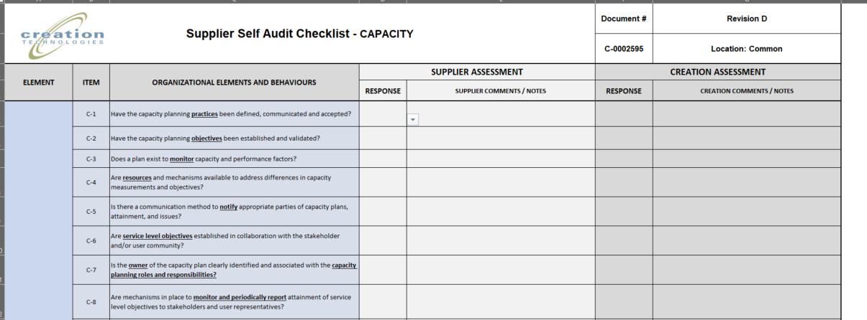
Capacity audit
Creation Representative will choose a response from the drop-down list to each question based on compliance observations made during the on-site audit and/or supporting documentation review.
Acceptable responses are N/A, NO, 1 or 2 (being 1 for partial compliance and 2 for fully compliant)
Supplier Representative will choose a response from the drop-down list based on current self assessment of each question. Acceptable responses are N/A, NO, 1 or 2 (being 1 for partial compliance and 2 for fully compliant)
Responses can be: 1, 2, NO, N/A
Supplier comments, notes, explanations or rationale for each response chosen can be recorded in this column.
Creation comments, notes, explanations or rationale for each response chosen can be recorded in this column.

Slide 8
REPORT DOCUMENT – SUPPLIER INFORMATION
Report that will be shared with the supplier and other stakeholders of the audit.
 | Supplier Audit Forms Checklist - REPORT |  |  | Document # | Revision D
 |  |  |  | C-0002595 | Location: Common
 |  |  |  | Scope: | SELECT
SUPPLIER INFORMATION
Audit Report Number: | 2022-NEW-001 | Audit Date 1: | 10/26/2022 | Audit Date 2: | 10/27/2022
Supplier Name: | NEW SUPPLIER | Supplier Number: | 123456 | Supplier Address: | NUMBER AND STREET
Supplier Contact Name and Title: | SUPPLIER CONTACT | Supplier contact Phone Number: | 125-265-5462 | Supplier Contact Email: | SUPPILER@SOMESUPPLIER.COM
Creation Audit Team |  |  | Supplier Audit Support Personnel
Audit Leader Name and Position | ONE SQE | SQE | Supplier Attendee and Position | SUPPLIER SUPPORT | SOME POSITION
Audit Member Name and Position | Name | Position | Supplier Attendee and Position | Name | Position
Audit Member Name and Position | Name | Position | Supplier Attendee and Position | Name | Position
Audit Member Name and Position | Name | Position | Supplier Attendee and Position | Name | Position
In information in this portion will auto-populate from the supplier information

Slide 9
REPORT DOCUMENT - SCORING
A summary of the audit scores will be presented in these cells.
The score explanation and color code will be presented in these cells
AUDIT SCORE
CAPACITY AUDIT SCORE | 72%
MANUFACTURER AUDIT SCORE | 5%
SCORE KEY
75-100 | Supplier reliable to work with Creation. Based on performance supplier is approved. If audit score is under 100% is still needed to work on continuous improvement plan.
51-75 | Supplier poses light risk, Creation can start or keep having business with supplier, however in parallel supplier must work on minor audit issues. Must meet basic requirements and should complete all findings and development plan to continuosly improve.
26-50 | Supplier poses risk, Creation may not recommend engaging business for a new supplier, for existing supplier a development plan with significant improvement must be completed.
25 or below | Supplier poses significant risk. For new suppliers Creation will not recommend to engage at present. If an existing supplier, FSIP must be initiated.

Slide 10
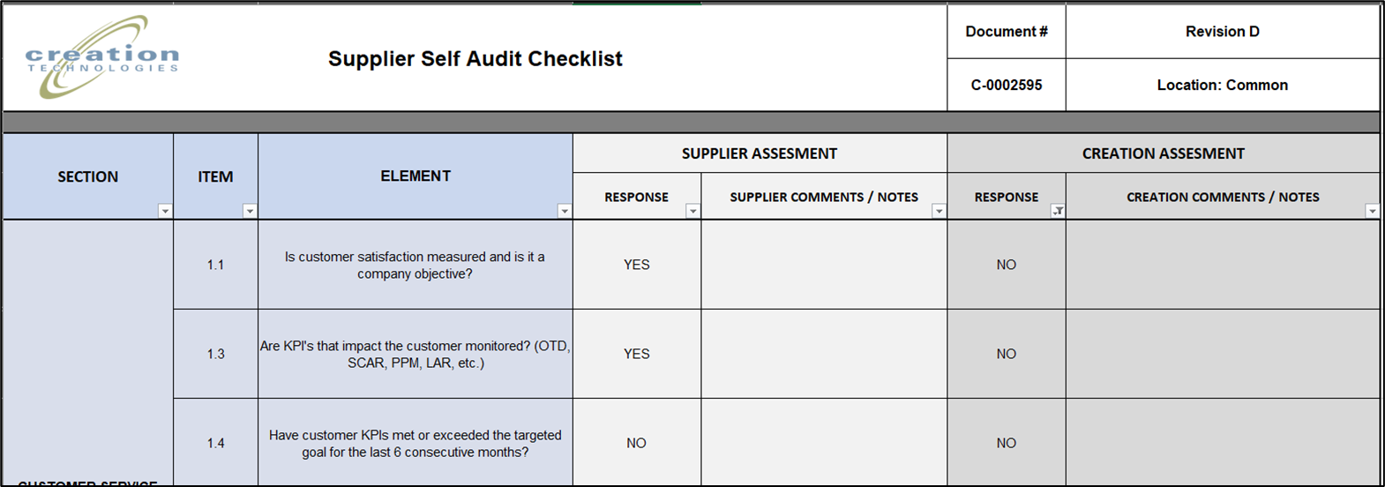
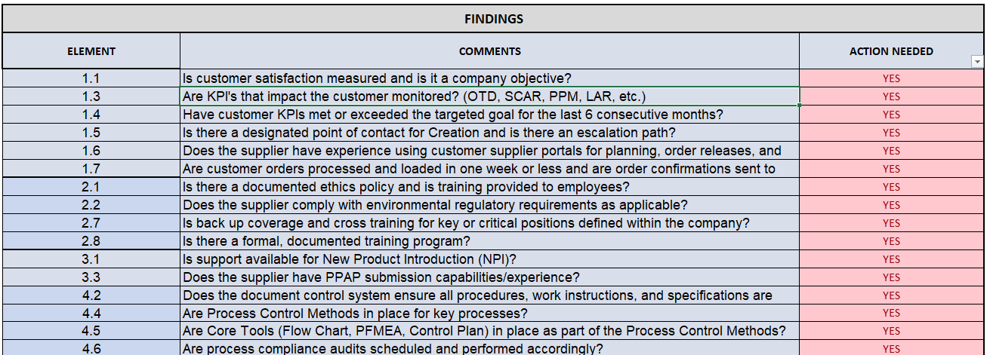
REPORT DOCUMENT – FINDINGS
This TAB is the report that will be shared with the supplier and other stakeholders of the audit.
For every element responded NO in Creation’s assessment
… there should be an entry in the FINDINGS section.

Slide 11
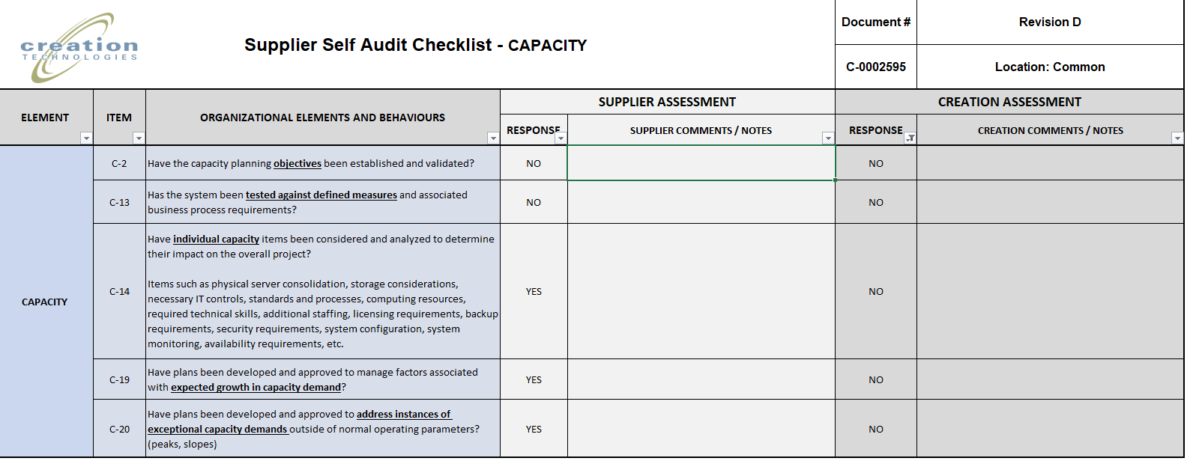
REPORT DOCUMENT – FINDINGS – Capacity Audit
… the “NO” responses in the CAPACITY AUDIT will need to be entered manually in the Report Document.

Slide 12
REPORT DOCUMENT- FINDINGS
The auditor will select if the finding requires an action from the drop-down list.

Slide 13
REPORT DOCUMENT - OBSERVATIONS
Observations made during the audit will be recorded here
The auditor will select if the observation requires an action the drop-down list

Slide 14
REPORT DOCUMENT
All positive observations from the audit will be recorded here.
POSITIVE OBSERVATIONS
Number | Comments
1 | Right contacts were available to support audit
2 | Information was available and ready on time for audit
3 | All the team was clear, trasparent and honest
4 | Supplier took in account quick wins, implemented during audit
5
6
7
8

Slide 15
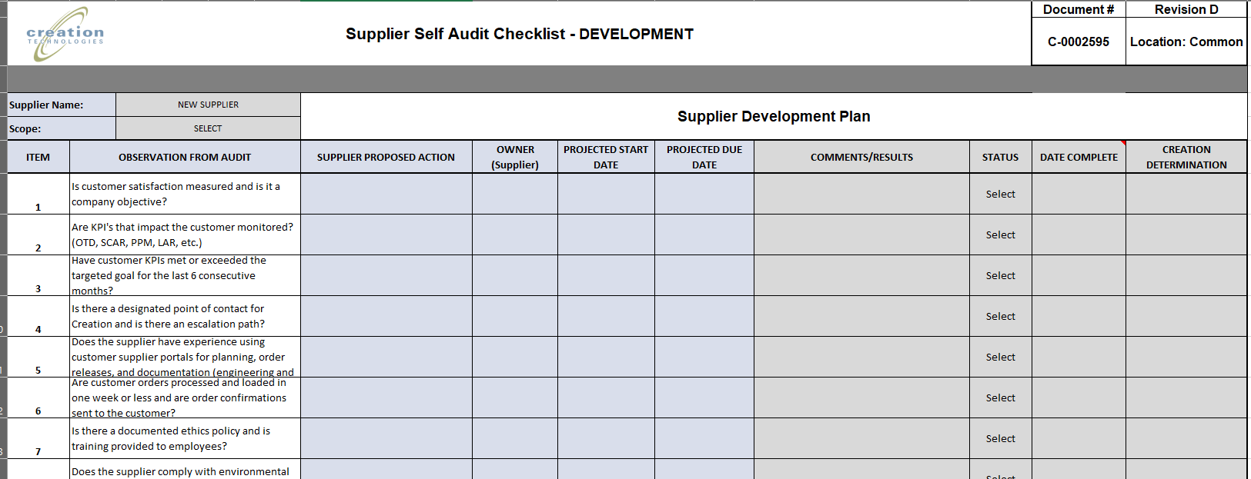
DEVELOPMENT PLAN
This TAB will serve as a tracker for the pending action items derived from the audit
Findings will auto copy in this section.
Observations will need to be add manually if action is needed.
Supplier is to fill up the cells in blue with the required information.
Cells in gray will be fill up by Creation auditor.

Slide 16
IMPORTANT NOTES
Findings, observations and positive comments will be reviewed during the wrap up meeting.
Supplier will send back fill up form to Creation auditor for follow up within the next 5 working days of receiving it.
Supplier and Creation will have to agree on actions needed.
Supplier and Creation will agree on the meetings schedule.
Creation auditor will share the audit file with the updated results with supplier.
Meetings schedule can be adjusted as needed and agreed upon.
Supplier team will review the list of observations, define action items and time frame for completion.
The audit is not considered close until ALL action items are closed and validated.

Slide 17
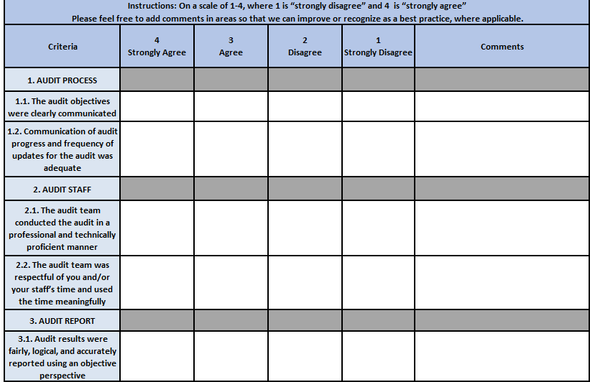
Audit Survey
We are very interested in getting feedback in regards of the audits the team performs.
Please take a few moments to respond to the short survey in the end of the audit and provide a reflection on your experiences in the areas of focus below.
We take your feedback very seriously and want to be sure we are learning from each engagement with our external partners.

