Slide 1
Supplier Audit Checklist Training C-0002595 Rev D.
9-26-2022
By Gilda Armenta

Slide 2
Supplier Self Audit Checklist Overview
The goal of the Supplier Self Audit Checklist is not only to understand the supplier’s current overall condition and identify risks to Creation; but also, to provide a path for the Supplier’s improvement and growth.
The supplier will go through the checklist and evaluate themselves in each section first.
Creation may or may not perform an On-Site audit, depending on any identified risks.
If Creation performs an on-site audit, the auditor may or may not evaluate every element of the supplier self audit depending on time allotted and associated identified risks.

Slide 3
ADDITIONAL DOCUMENTATION
THE FOLLOWING DOCUMENTATION MAY BE REQUESTED DURING THE ON SITE AUDIT.
Calibration Schedule.
If external party, Calibration Certificate.
Maintenance Schedule.
Maintenance Order and Report .
Internal (Layered) Audit Schedule (if any).
Internal Audit Questionnaire (if any).
Layered Audits Schedule (if any).
Training Record and Matrix for supplier employee(s) chosen by the auditor. Core Tools for 1 Creation Part Number, if applicable, or the current highest runner: (Flow chart, PFMEA, CP).
Quality Inspection Records for the last week of Creation's Part Number or the highest runner part.
Metrics: OTD metrics of the last 12 months.
PPM (external and internal) of the last 12 months.
SCRAP of the last 12 months.

Slide 4
TAB’s INDEX
History of Changes
Instructions
Supplier Information
Full Audit TAB
Capacity Audit TAB
Report Document
Development Plan

Slide 5
SUPPLIER INFORMATION TAB
Creation Representative will select the scope of the audit from this drop-down list
Creation Representative will fill out the Supplier Information in these fields.
Supplier will fill up the Supplier Audit Support Personnel cells with the required information.

Slide 6
FULL AUDIT TAB
Supplier Representative will choose a response from the drop-down list based on current self assessment of each question.
Creation Representative will choose a response from the drop-down list to each question based on compliance observations made during the on-site audit.
Responses can be: YES, NO, N/A
Supplier comments, notes, explanations or rationale for each response chosen can be recorded in this column.
Creation comments, notes, explanations or rationale for each response chosen can be recorded in this column.

Slide 7
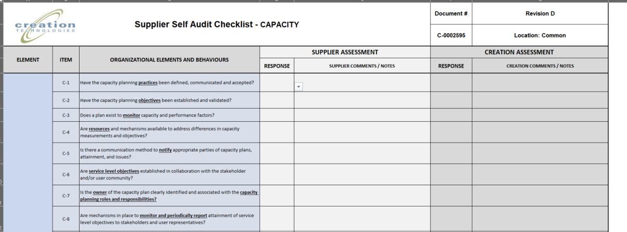
CAPACITY AUDIT TAB
Supplier Representative will choose a response from the drop-down list based on current self assessment of each question.
Creation Representative will choose a response from the drop-down list to each question based on compliance observations made during the on-site audit and/or supporting documentation review.
Responses can be: YES, NO, N/A
Supplier comments, notes, explanations or rationale for each response chosen can be recorded in this column.
Creation comments, notes, explanations or rationale for each response chosen can be recorded in this column.

Slide 8
REPORT DOCUMENT – SUPPLIER INFORMATION
This TAB is the report that will be shared with the supplier and other stakeholders of the audit.
 | Supplier Self Audit Checklist - REPORT |  |  | Document # | Revision D
 |  |  |  | C-0002595 | Location: Common
 |  |  |  | Scope: | SELECT
SUPPLIER INFORMATION
Audit Report Number: | 2022-NEW-001 | Audit Date 1: | 10/26/2022 | Audit Date 2: | 10/27/2022
Supplier Name: | NEW SUPPLIER | Supplier Number: | 123456 | Supplier Address: | NUMBER AND STREET
Supplier Contact Name and Title: | SUPPLIER CONTACT | Supplier contact Phone Number: | 125-265-5462 | Supplier Contact Email: | SUPPILER@SOMESUPPLIER.COM
Creation Audit Team |  |  | Supplier Audit Support Personnel
Audit Leader Name and Position | ONE SQE | SQE | Supplier Attendee and Position | SUPPLIER SUPPORT | SOME POSITION
Audit Member Name and Position | Name | Position | Supplier Attendee and Position | Name | Position
Audit Member Name and Position | Name | Position | Supplier Attendee and Position | Name | Position
Audit Member Name and Position | Name | Position | Supplier Attendee and Position | Name | Position
In information in this portion will auto-populate from the Supplier Information TAB

Slide 9
REPORT DOCUMENT - SCORING
A summary of the Audit Scores will be presented in these cells.
The Score Explanation and color code will be presented in these cells
SCORE COLOR CODE
75-100 | Ready to work with Creation
51-75 | We can Work with the supplier in parallel they work on minor audit issues.
26-50 | Supplier needs a development plan to work on audit issues before we engage in business.
25 or below | Supplier poses significant risk; Creation will not engage at present.
AUDIT SCORE
CAPACITY AUDIT SCORE | 72%
FULL AUDIT SCORE | 5%
Note how the cells are colored in accordance with the score obtained

Slide 10
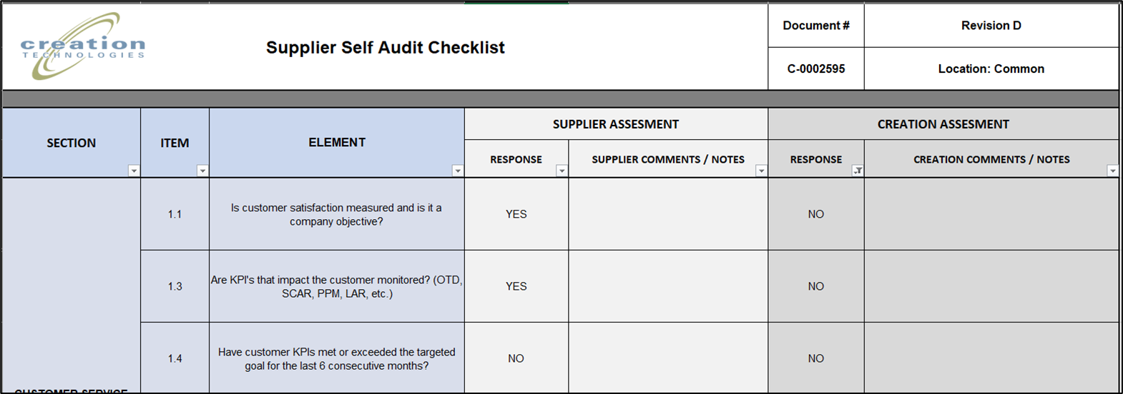
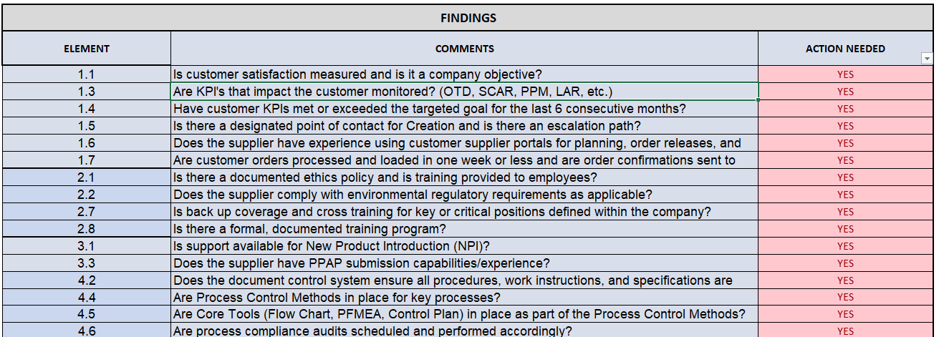
REPORT DOCUMENT – FINDINGS - Full Audit
This TAB is the report that will be shared with the supplier and other stakeholders of the audit.
For every element responded NO in Creation’s assessment
… there should be an entry in the FINDINGS section.
These will auto-populate from the Full Audit TAB …

Slide 11
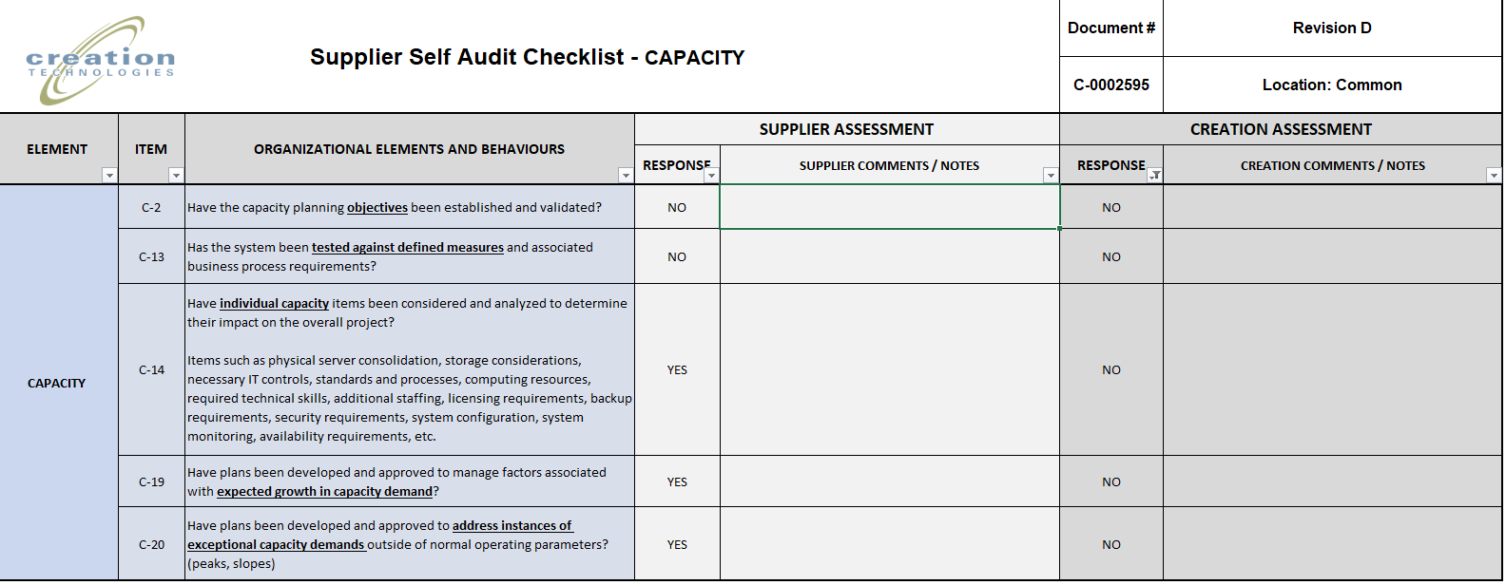
REPORT DOCUMENT – FINDINGS – Capacity Audit
… the “NO” responses in the CAPACITY AUDIT will need to be entered manually in the Report Document.

Slide 12
REPORT DOCUMENT- FINDINGS
The auditor will select if the finding requires an action from the drop-down list.

Slide 13
REPORT DOCUMENT - OBSERVATIONS
Observations made during the audit will be recorded here
The auditor will select if the observation requires an action the drop-down list

Slide 14
REPORT DOCUMENT
All positive observations from the audit will be recorded here.
POSITIVE OBSERVATIONS
Number | Comments
1 | People were friendly and discussed their favorite Marvel picture openly.
2 | I was pleased to see a person wearing a “Wakanda Forever” shirt.
3 | One of the buyers have her desk full of Marvel Collectibles.
4 | Congratulations to upper management for encouraging their employees to watch all Marvel Movies.
5
6
7
8

Slide 15
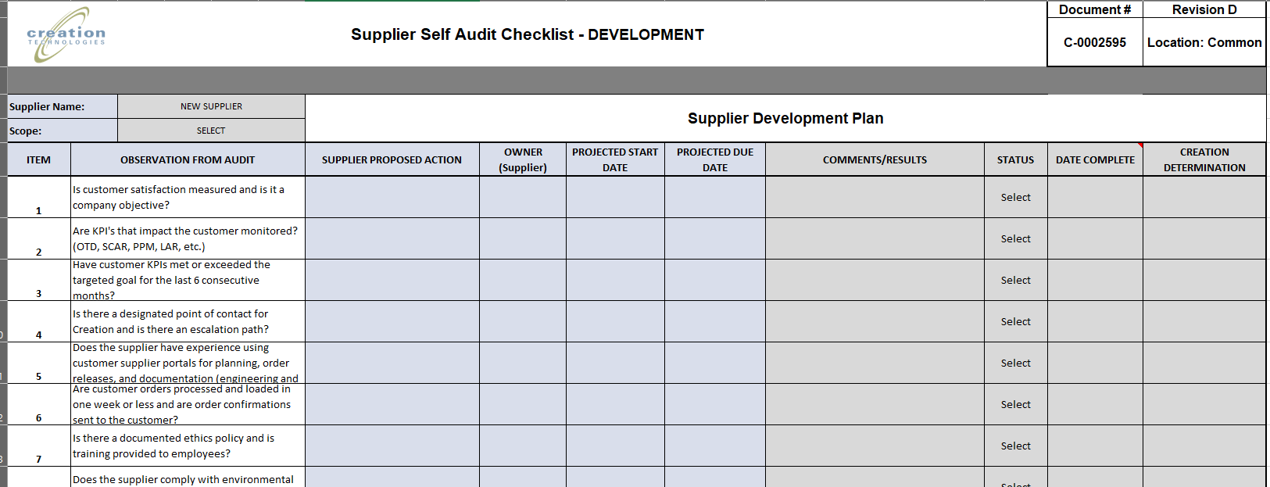
DEVELOPMENT PLAN
This TAB will serve as a tracker for the pending action items derived from the audit
Findings will auto copy in this section.
Observations will need to be add manually if action is needed.
Supplier is to fill up the cells in blue with the required information.
Cells in gray will be fill up by Creation auditor.

Slide 16
IMPORTANT NOTES
Findings, Observations and Positive Comments will be reviewed during the wrap up meeting.
Supplier will send back fill up form to Creation Auditor for follow up within the next 5 working days of receiving it.
Supplier and Creation will have to agree on Actions needed.
Supplier and Creation will agree on the meetings schedule.
Creation Auditor will share the audit file with the updated results with supplier.
Meetings schedule can be adjusted as needed and agreed upon.
Supplier Team will review the list of observations, define action items and time frame for completion.
The audit is not considered close until ALL action items are closed and validated.

Slide 17
QUESTIONS?

